Slide 1
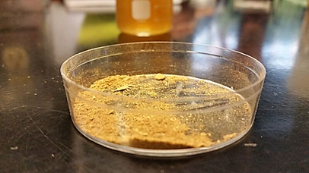

Slide 2
The Effect of Cigarettes on Planaria Regeneration
By: Jonathan Quang, Jason Mei, Levi Olevsky, Minhein Htet, Max Zlotskiy
Ms.Quenzer Stuyvesant Highschool November 22, 2015

Slide 3
Objective
The objective of this experiment was to gauge how an increase in cigarette concentration affects the regeneration rate or growth of planaria.
This experiment could be seen as a way of testing how cigarettes reduce our bodies’ capacity to grow more cells.

Slide 4
Hypothesis
If cigarette extract concentration increases, the rate of planaria regeneration would ultimately decrease because cigarettes contain a variety of harmful chemicals, such as nicotine, ammonia, and arsenic, which are generally toxic to animals.
At the low concentrations being tested for this experiment, it was expected that some would die or at least shrink in length.

Slide 5
Materials
6 Petri Dishes
Spring Water
Distilled Water
3 Planaria
1 Dissection Kit, containing a scalpel and a probe
4 Russian Slim Cigarettes
Graduated Cylinders
Mortar and Pestle
1 Ruler
Graph paper
Egg Yolk
Dissection Microscope
Pipette
Filter Paper

Slide 6
Procedure Part 1
We removed the cigarette wrapper and filter; then we poured the powder into the mortar and pestle.
The powder was ground into a fine powder.
Water was added to make solutions of 1/4%, 1/8%, and 1/16%
Using the filter paper, the sediments were filtered out.
15 mL of the filtered solution was poured into a petri dish.
In the corresponding petri dishes (controls), 15 mL of spring water was poured into them.
A horizontal cut was made on three different planaria.

Slide 7
Procedure Part 2
8. Using the pipette, one half of a planarian was transferred into a petri dish with the ¼ % solution.
9. Using the pipette, the other half was transferred into the corresponding petri dish, filled with 15mL of water.
10. Repeat steps 6 and 7 for ⅛ % and 1/16 % solutions.
11. The lengths of each planarian were recorded once a day. This wasn’t possible to do everyday. The length of each planarian should be measured when it is elongated
12. Each planarian-half was fed little bits of egg once a week and the water of each container was replaced once every three days.
13. Compared data to see if correlation exists between the concentration of mashed cigarette and regeneration rate.

Slide 8
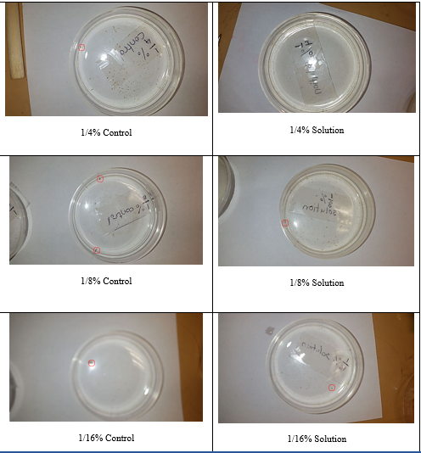
Controls
Solutions
1/4%
*The red circles surround the planaria in their respective dishes
**All photos on this page were taken on November 17, 2015
1/8%
1/16%

Slide 9
Length of Planaria In Solutions with Varying Concentrations of Cigarette Extract (cm)
Date | ¼% Concentration | ¼% Control | ⅛% Concentration | ⅛% Control | 1/16 % Concentration | 1/16 % Control
11/5 | 0.25 cm | 0.2 cm | 0.2 cm | 0.5 cm | 0.25 cm | 0.25 cm
11/10 | 0.25 cm | 0.2 cm | 0.3 cm | 0.6 cm | 0.35 cm | 0.25 cm
11/13 | DEAD | 0.15 cm | 0.2 cm | 0.5 cm | 0.2 cm | 0.2 cm
11/15 | DEAD | 0.2 cm | 0.5 cm | Planaria split into 0.2 cm halves | 0.3 cm | 0.25 cm
11/17 | DEAD | 0.3 cm | 0.3 cm | 0.3 cm 0.3 cm | 0.15 cm | 0.1 cm
11/18 | DEAD | 0.2 cm | 0.3 cm | 0.25 cm 0.2 cm | 0.2 cm | 0.25 cm

Slide 10
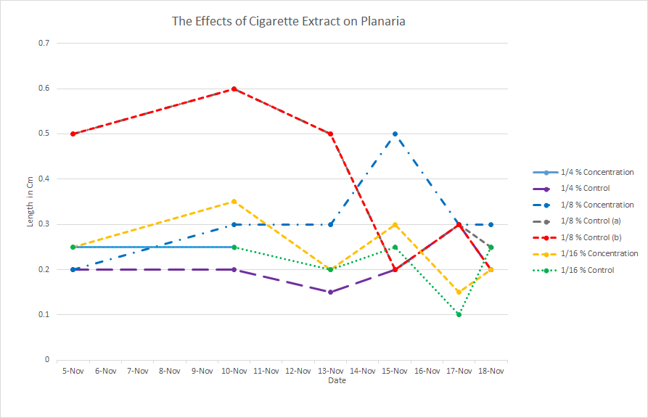

Slide 11
Conclusion
Based upon our observations, we have concluded that our initial hypothesis was partially correct.
The results of the experiment showed that the effect of the solution on the planaria depended on the concentration of the solution.
At high concentrations such as ¼% and above, the planaria died.
At medium concentrations such as ⅛%, the planaria in the solution did not regenerate as fast as the planaria in the control.
At low concentrations such as 1/16% the planaria in the control and the solution ended up growing at about the same rate.
Note that for ⅛% and 1/16%, that periods of somewhat fast growth were met quickly with periods of shrinkage. This leads to the conclusion that high concentrations of cigarette extract resulted in death while lower concentrations resulted in unstable growth.

Slide 12
Reflection
During the experiment, we did run into some problems that we did and did not expect.
The first problem was the difficulty of cutting planaria into exact halves. The planaria either curled up into balls or would not stop moving. This lead to some uneven cuts.
Other problems included trying to measure the length of some of the planaria. For example, the planaria often refused to stretch and therefore, the lengths were inconsistent.
We had to measure each planaria several times.
We also noticed some surprising things. For instance, the planaria in ¼ % solution would not stop wiggling about even if we left it alone.
The planaria also shrunk in size during the experiment.

Slide 13
References
Cigarette Ingredients - Chemicals in Cigarettes. (n.d.). Retrieved November 23, 2015, from
http://www.tricountycessation.org/tobaccofacts/Cigarette-Ingredients.html
Pietranglo, A. (2014, August 25). The Effects of Smoking on the Body. Retrieved November 23,
2015, from http://www.healthline.com/health/smoking/effects-on-body
Rawls, S., Patil, T., Tallarida, C., Baron, S., Kim, M., Song, K., . . . Raffa, R. (2011, May 6).
Nicotine behavioral pharmacology: Clues from planarians. Retrieved November 23,
2015, from http://www.ncbi.nlm.nih.gov/pmc/articles/PMC3163013

